Slide 1


OS – File controlling system

Slide 2
Presented by :
Sazzad Hossain Shihab
Student id: 221902182
MD Rakib Sarder
Student id: 221902377
Department of CSE
Green University of Bangladesh
Presented to :
Md. Rajibul Palas
Lecturer
Green University of Bangladesh

Slide 3
Table of Contents
Introduction
Overview
Goals and objectives
Features
Details of project
Advantages
Future work
Conclusion

Slide 4
Introduction
"Os- File Controlling System" project is to provide the users access to a full range of operating system-based file management features and capabilities.

Slide 5
Overview
The main goal of the "Os- File Controlling System" project is to provide the users access to a full range of operating system-based file management features and capabilities. users can list files and direc- tories,create new files,delete existing ones,rename files,edit the content of files,search for files,view the content of files,view file details,sort the content of files,and more using a menu-driven system

Slide 6
Goals and objectives
User-Friendly Interface
Efficiency and Performance
Flexibility and Customization
Interoperability and Compatibility

Slide 7
Features
User interface
2. Operating system file controlling systems
List all files and directories
Create new files
Edit file content
Rename file
Searching file
Details of particular file
Count number of files

Slide 8
Sort file content
List only directories in folders
Count number of directories
View Content of File
Delete Existing Files
Sort Files in a Directory
List Files of Particular Extension
Login
Signup

Slide 9
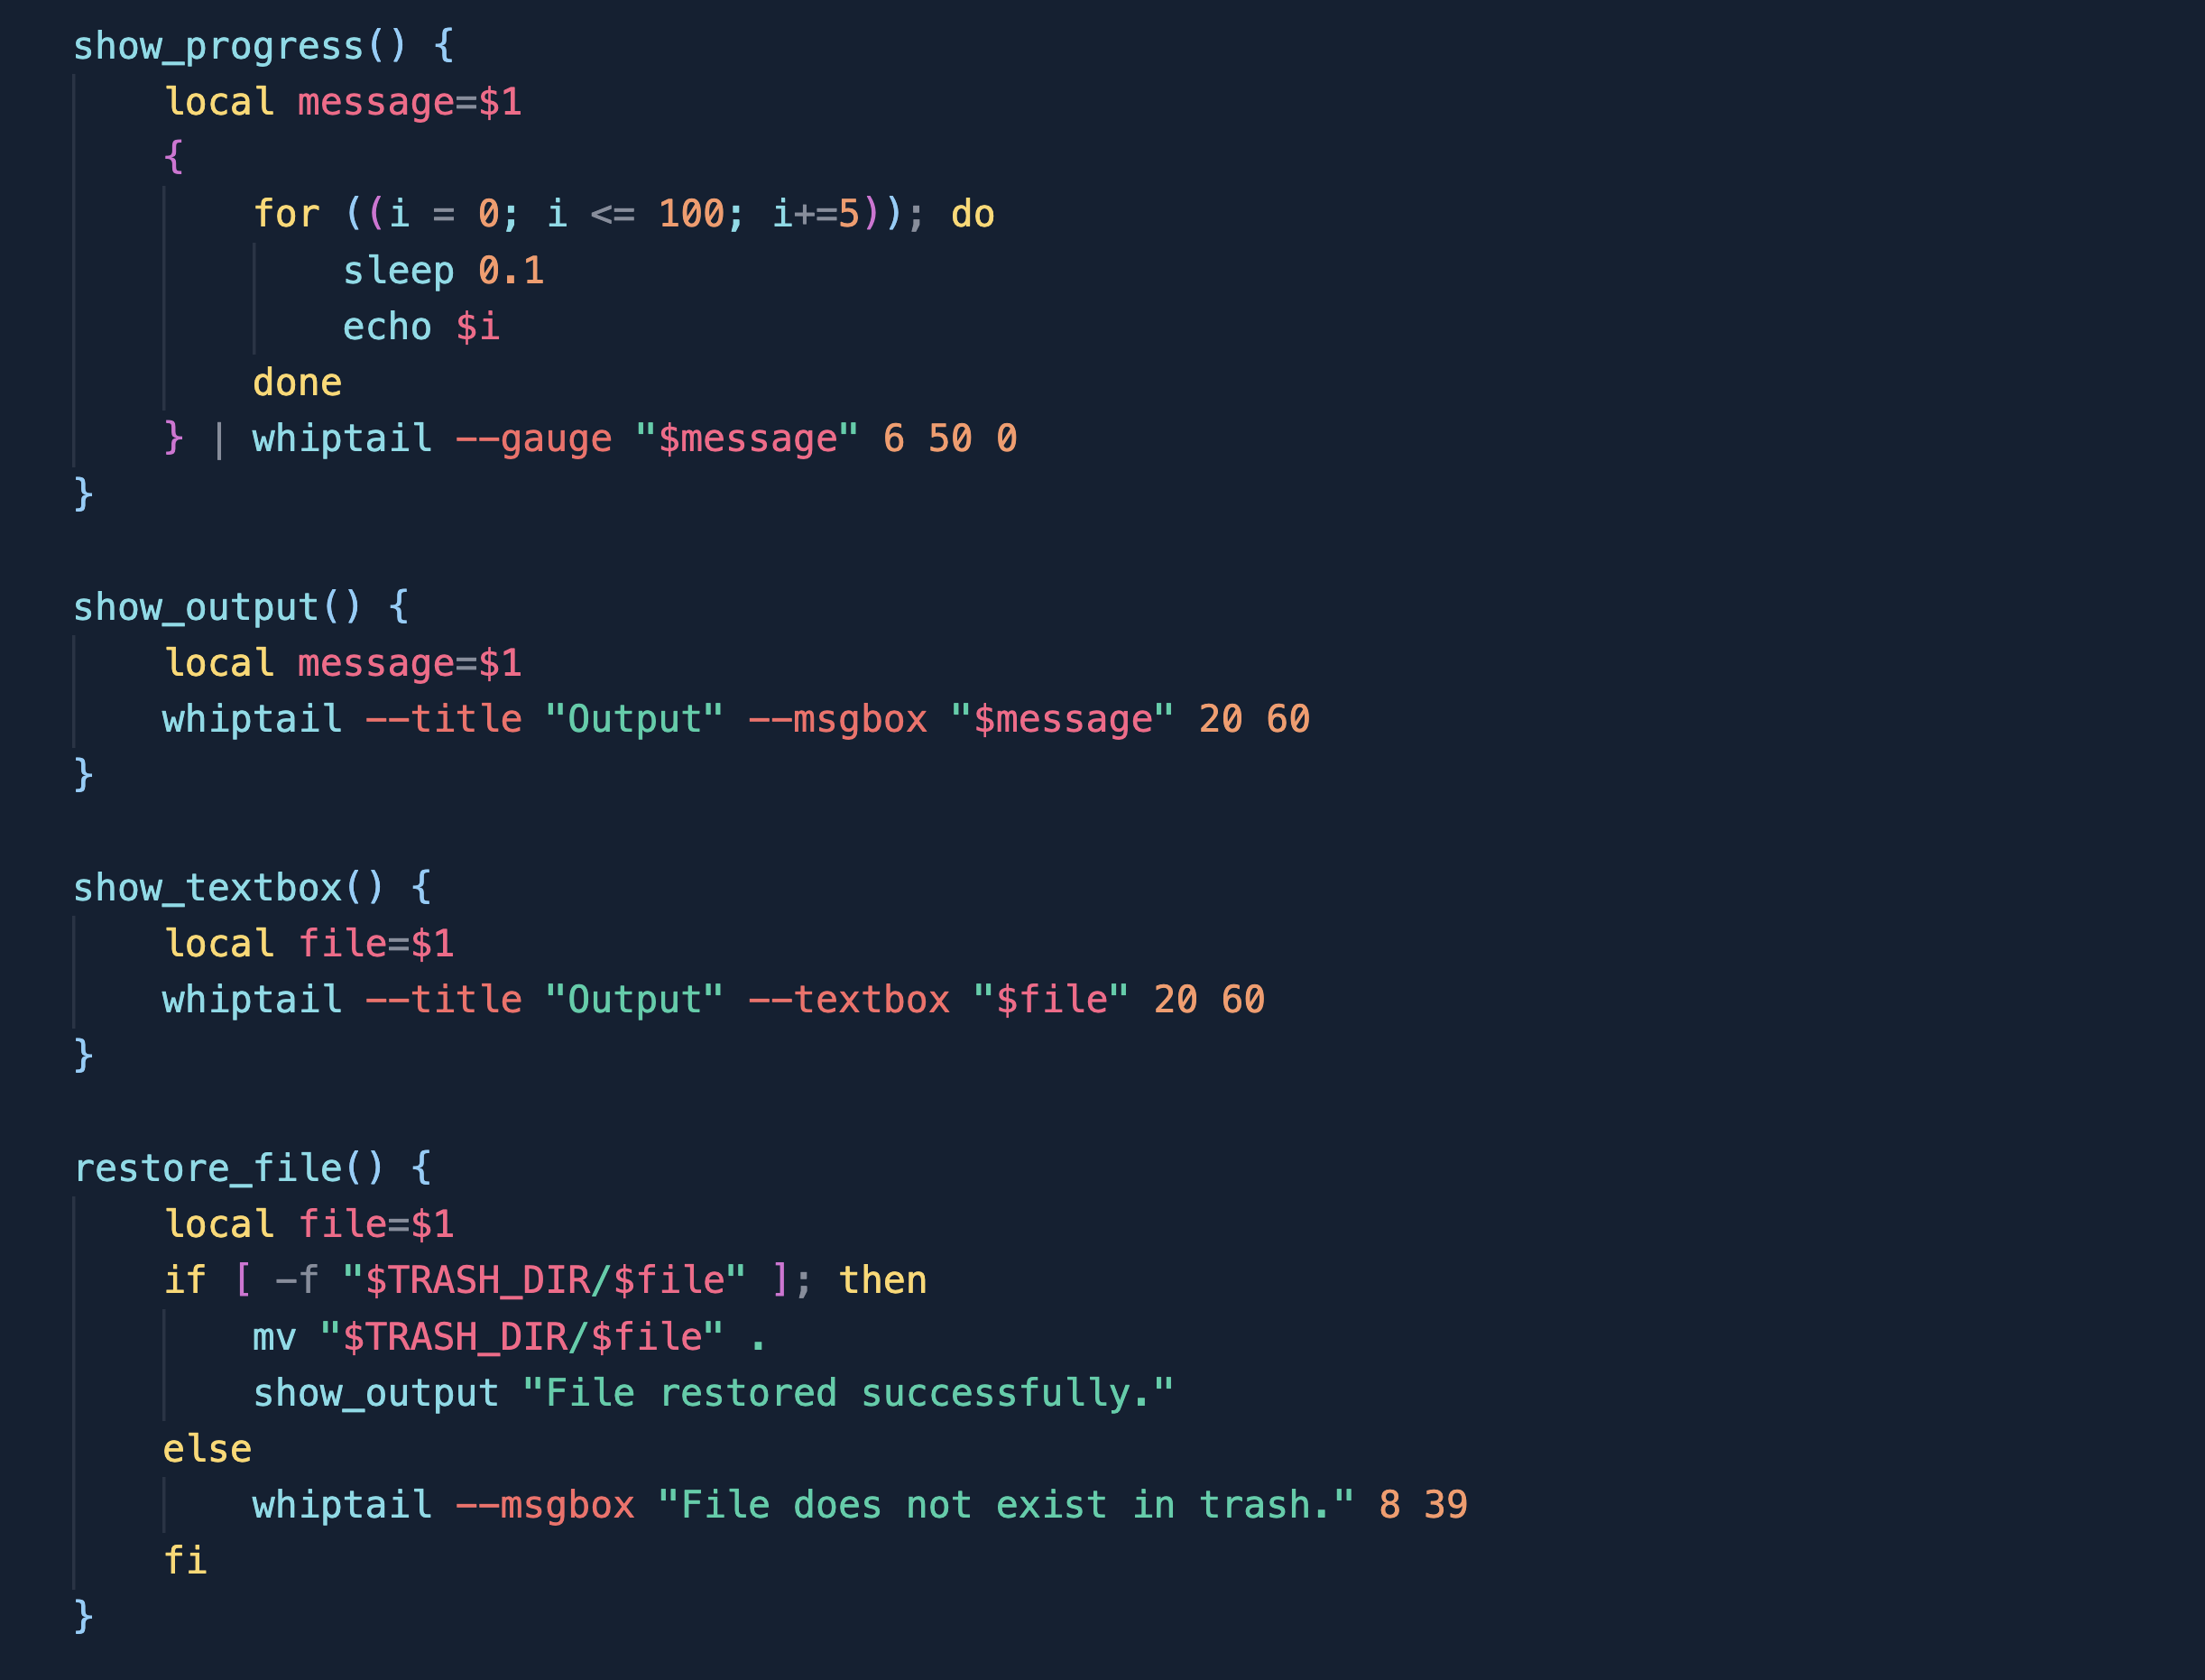
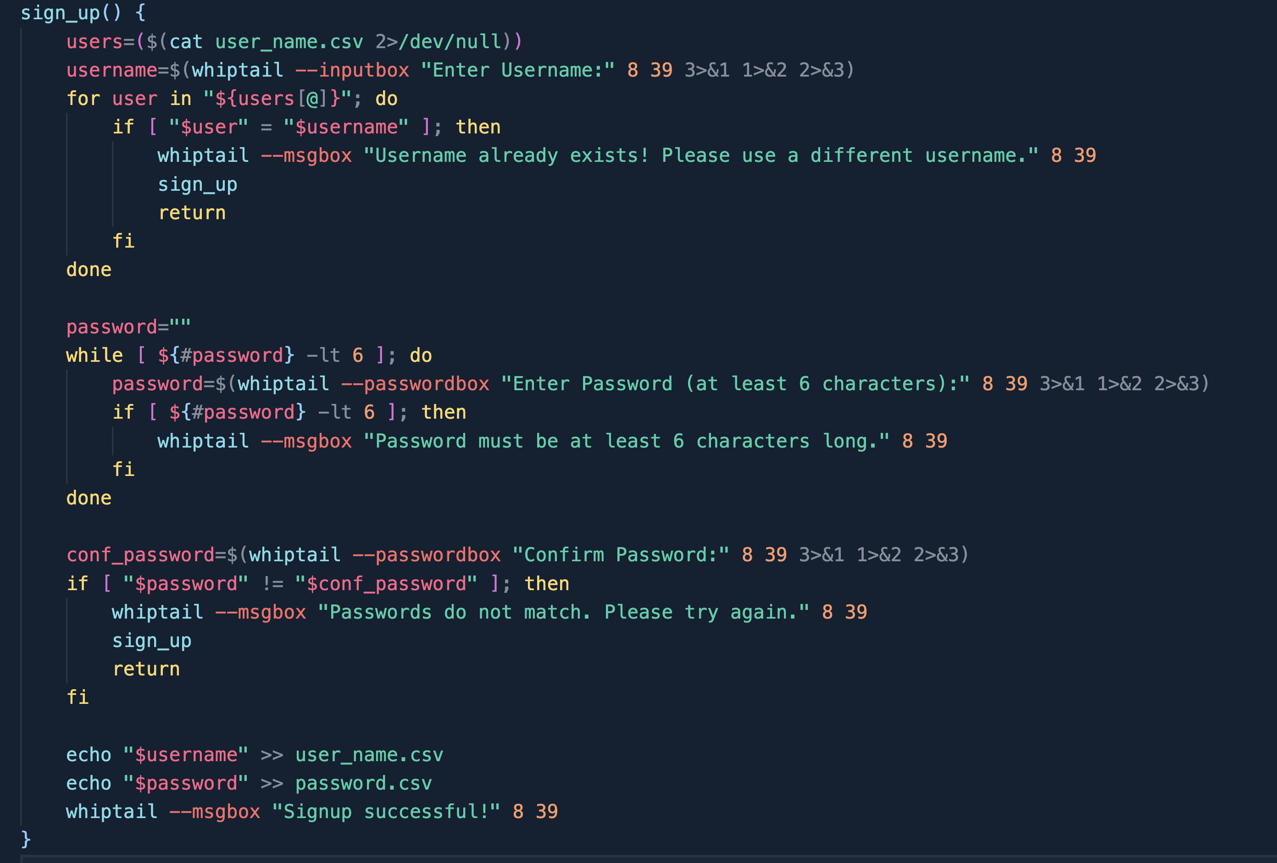
Details
Implementation
Figure 1: Some Functions
Figure 2: Signup

Slide 10
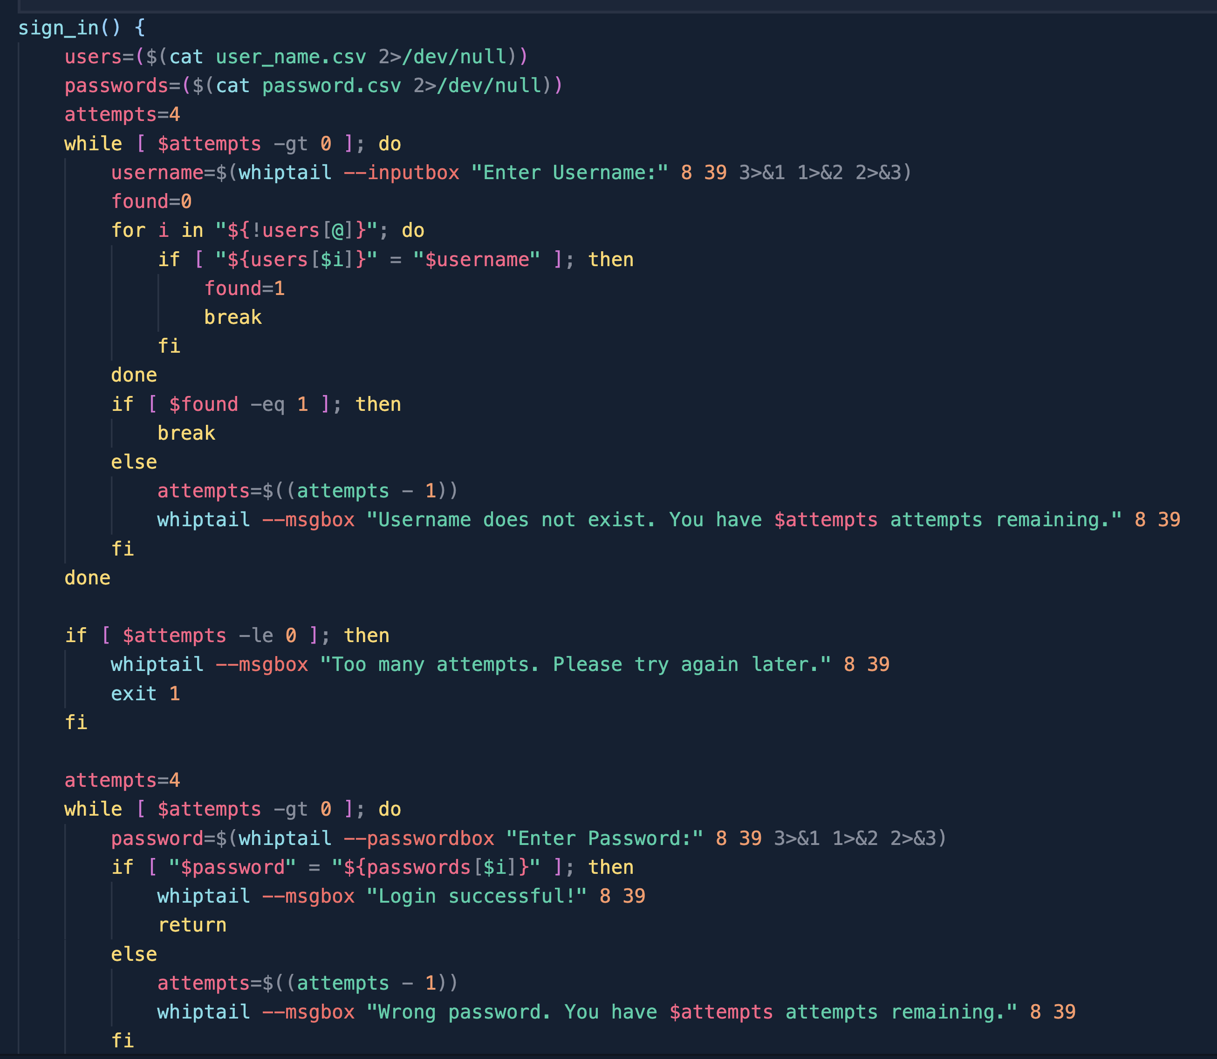
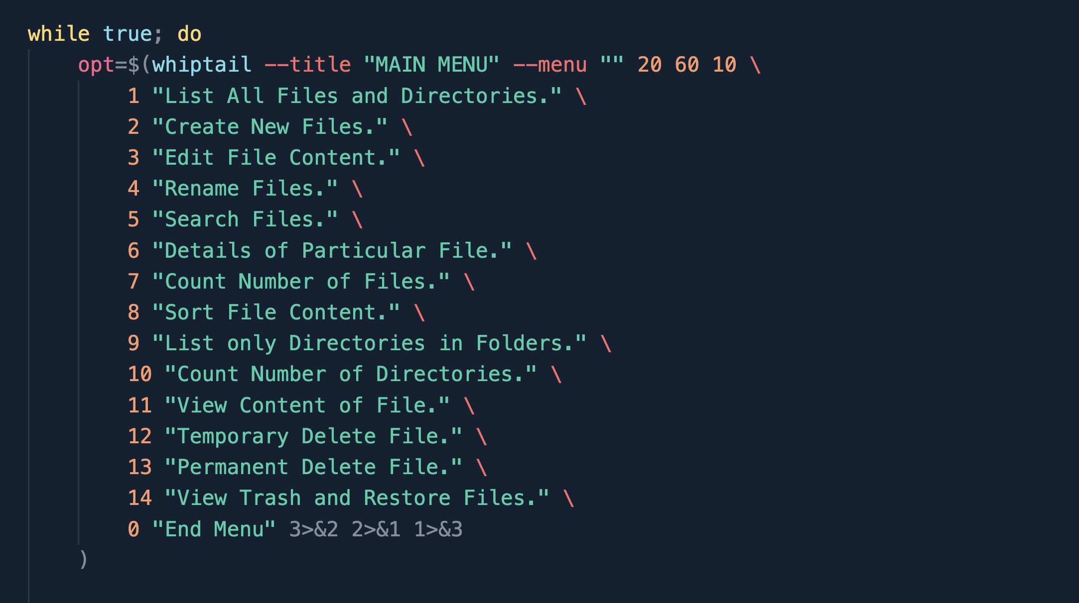
Details
Implementation
Figure 4: Menu
Figure 3: Sign in

Slide 11
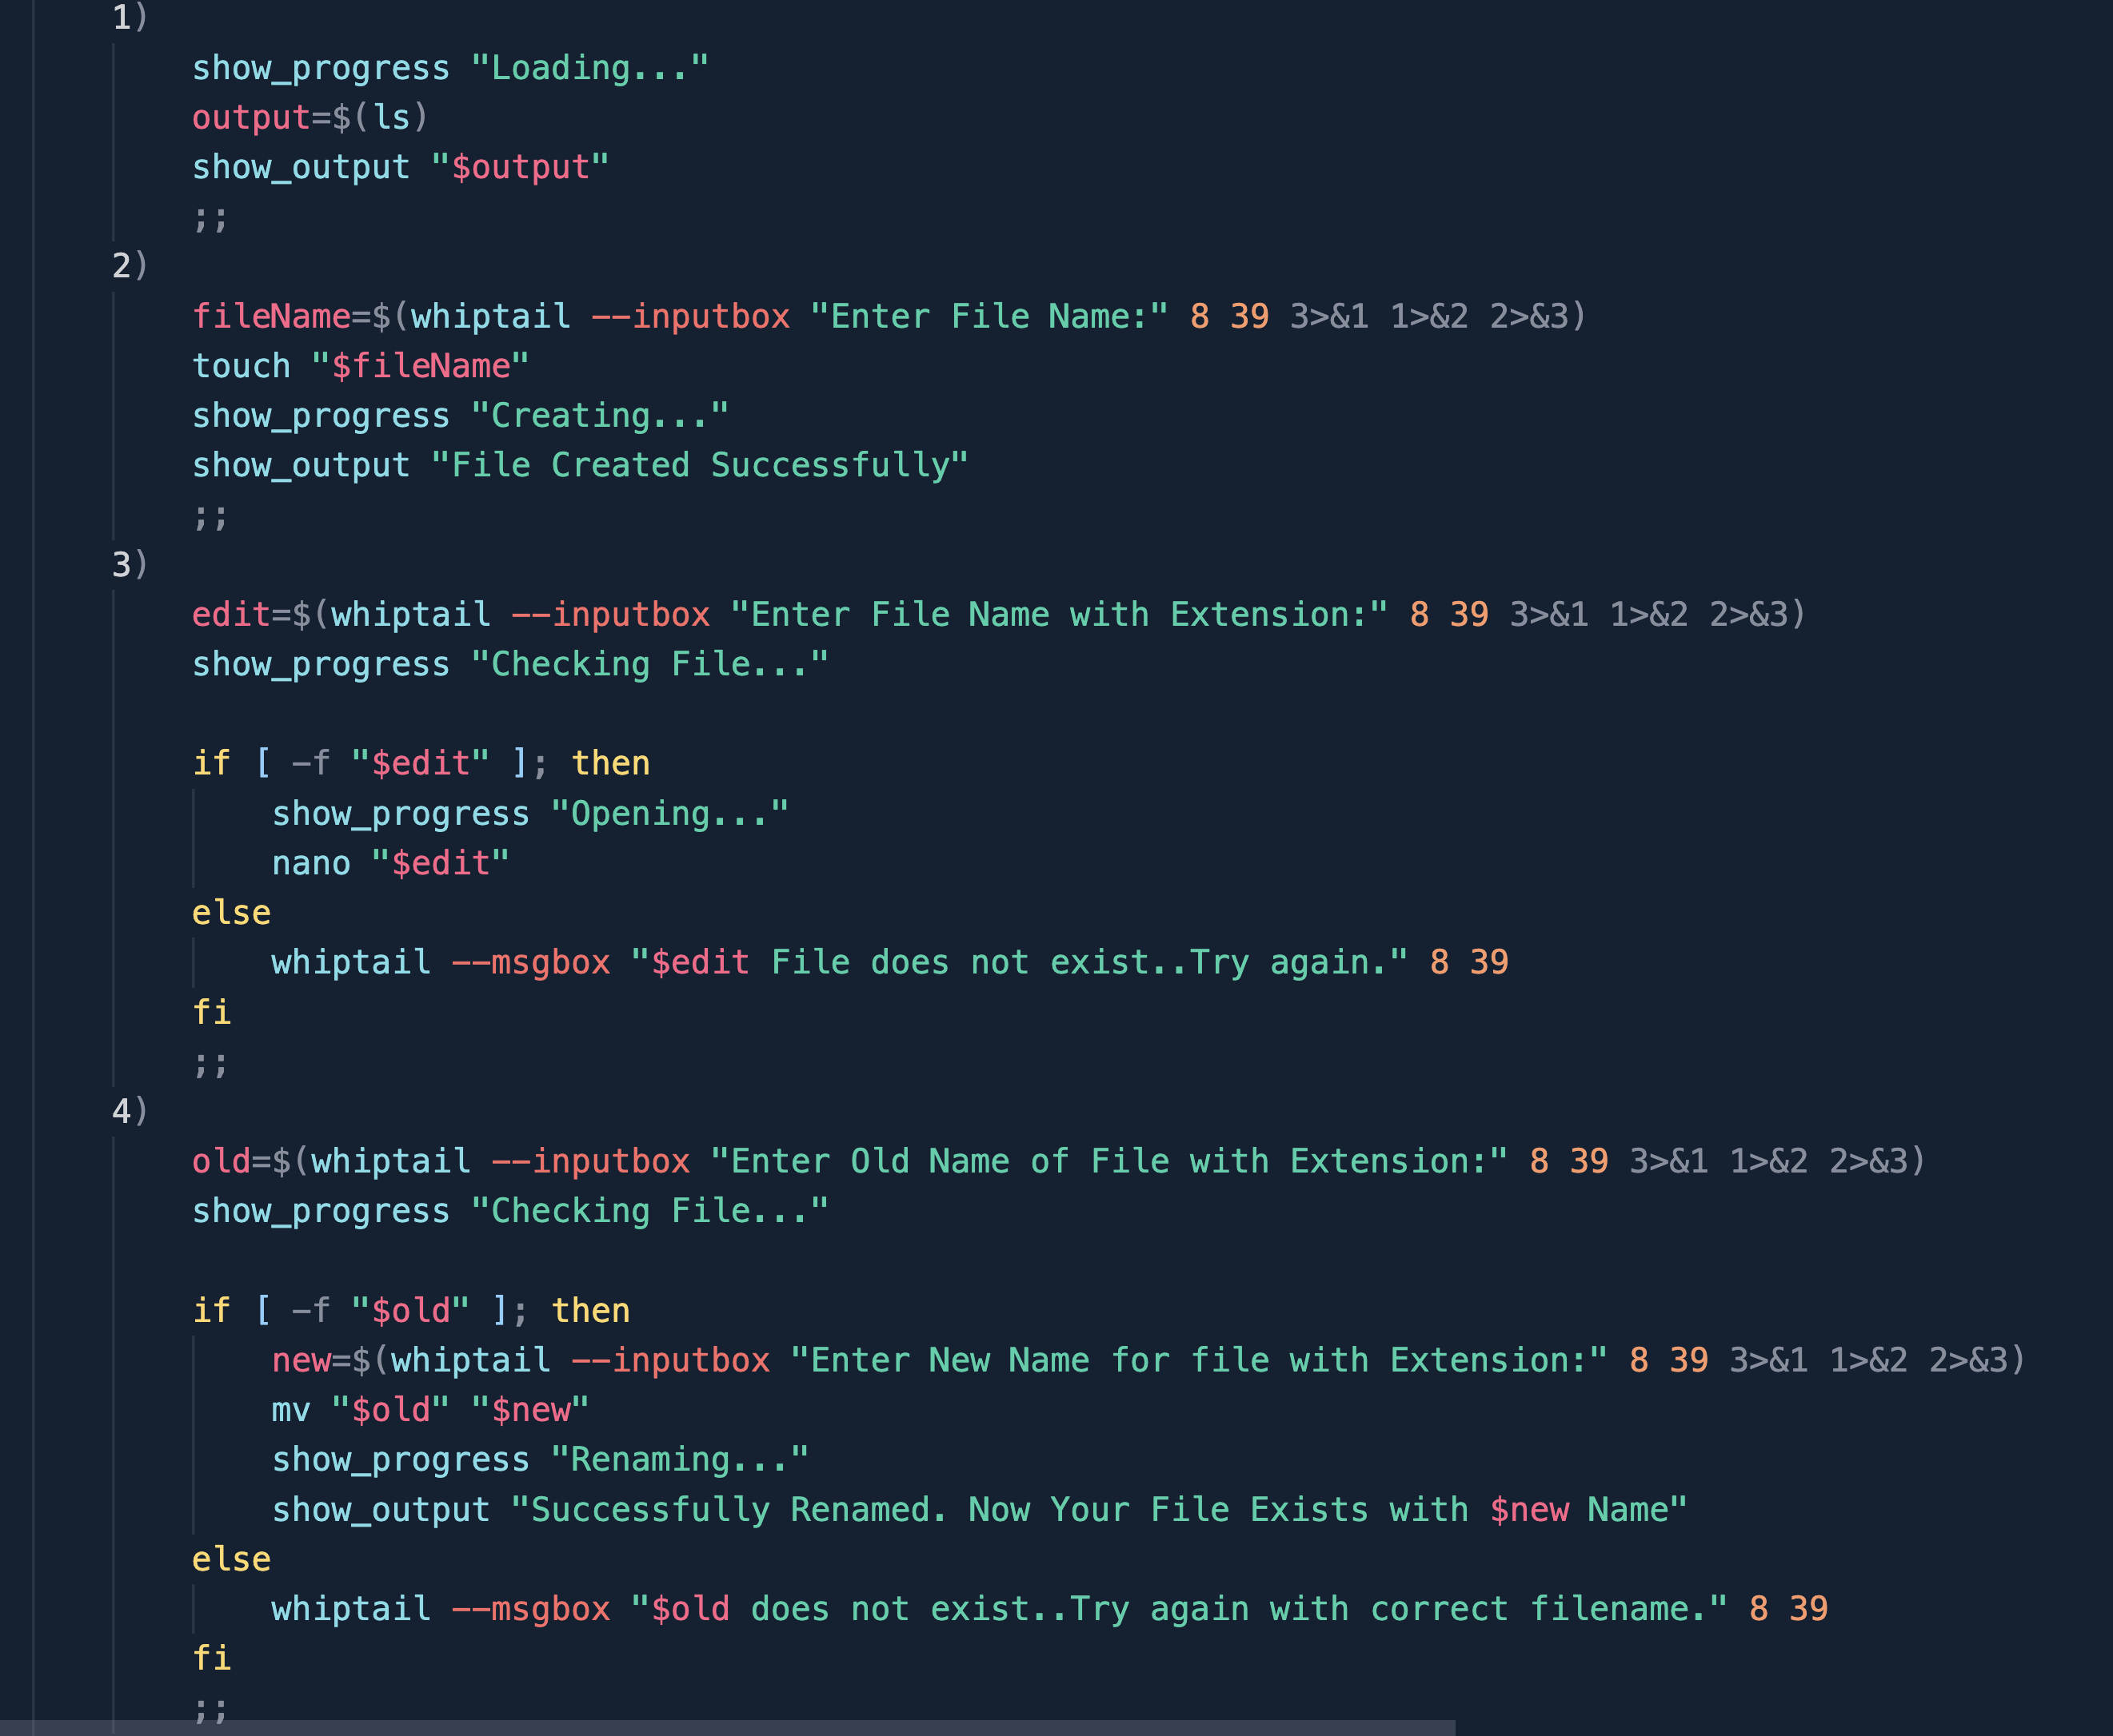
Details
Implementation
Figure 5: Code for the Menu options

Slide 12
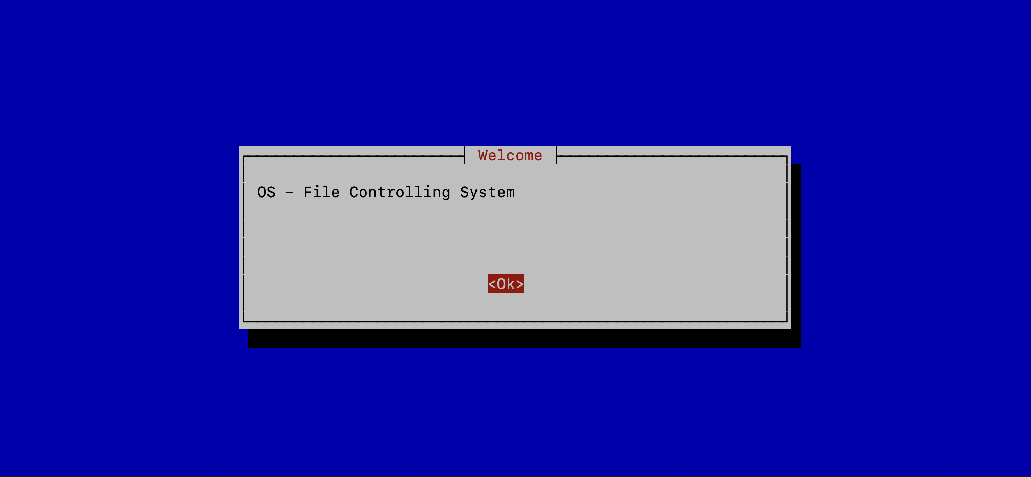
Result:
Figure 6: Welcome

Slide 13
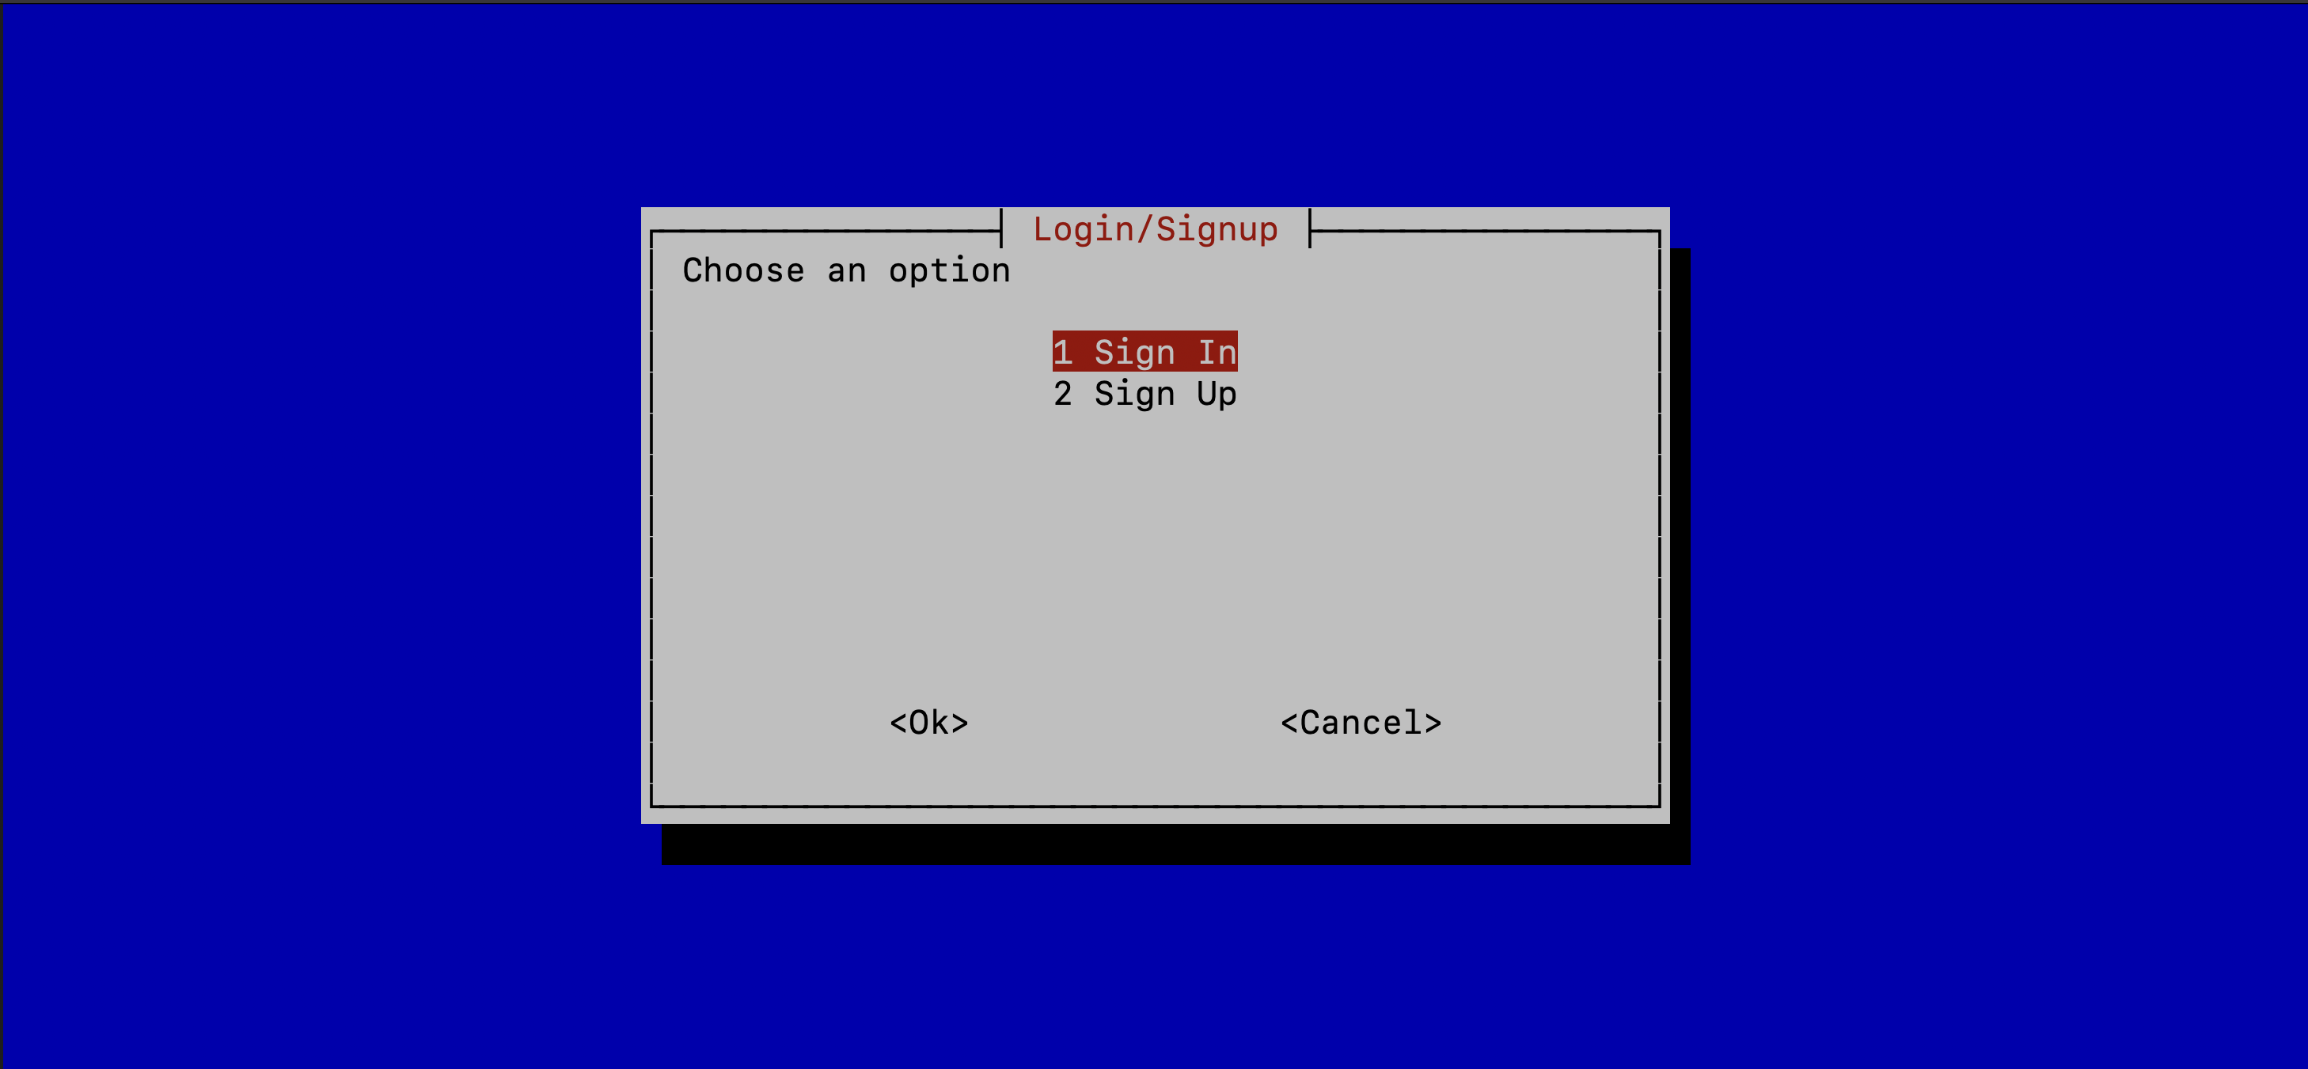
Result:
Figure 7: Signin and Signup

Slide 14
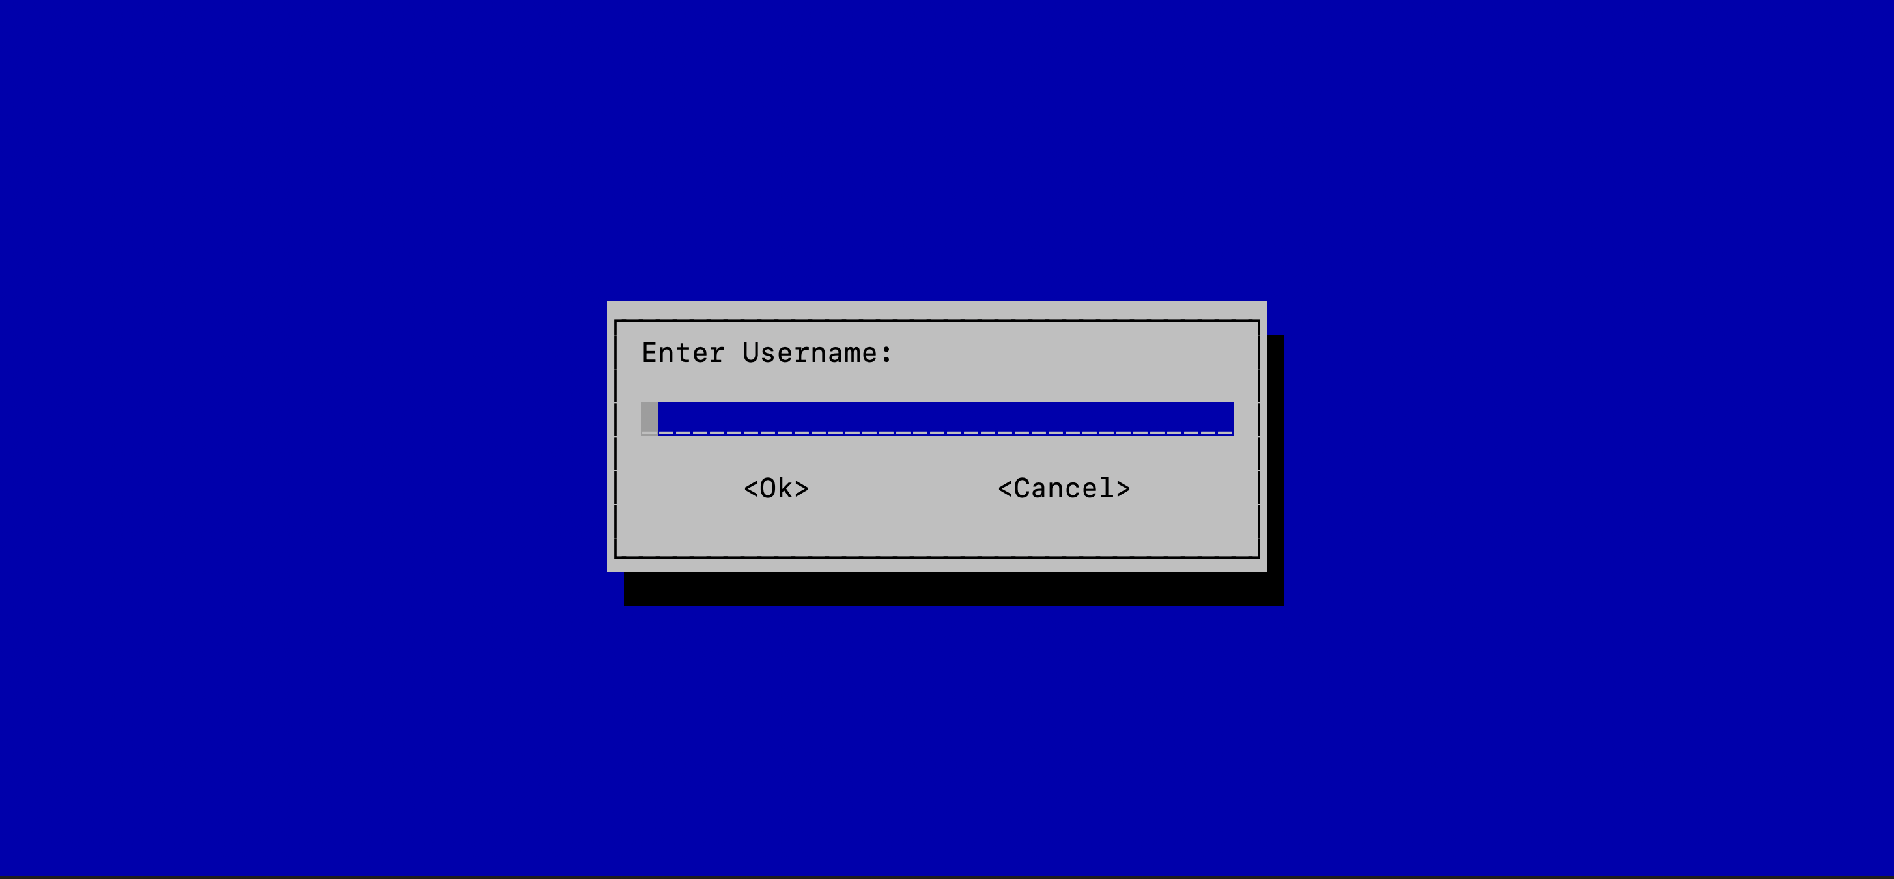
Result:
Figure 8: Submitting Username

Slide 15
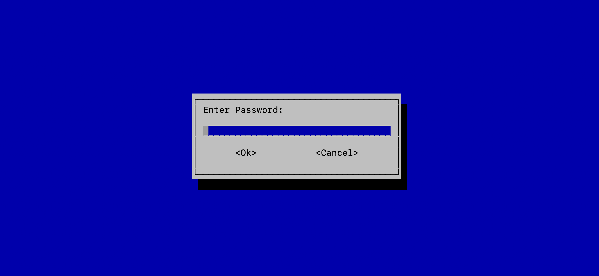
Result:
Figure 9: Submitting Password

Slide 16
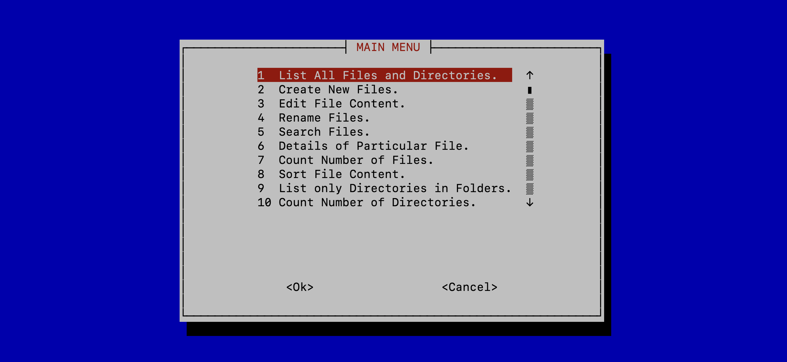
Result:
Figure 10: Showing the Menu

Slide 17
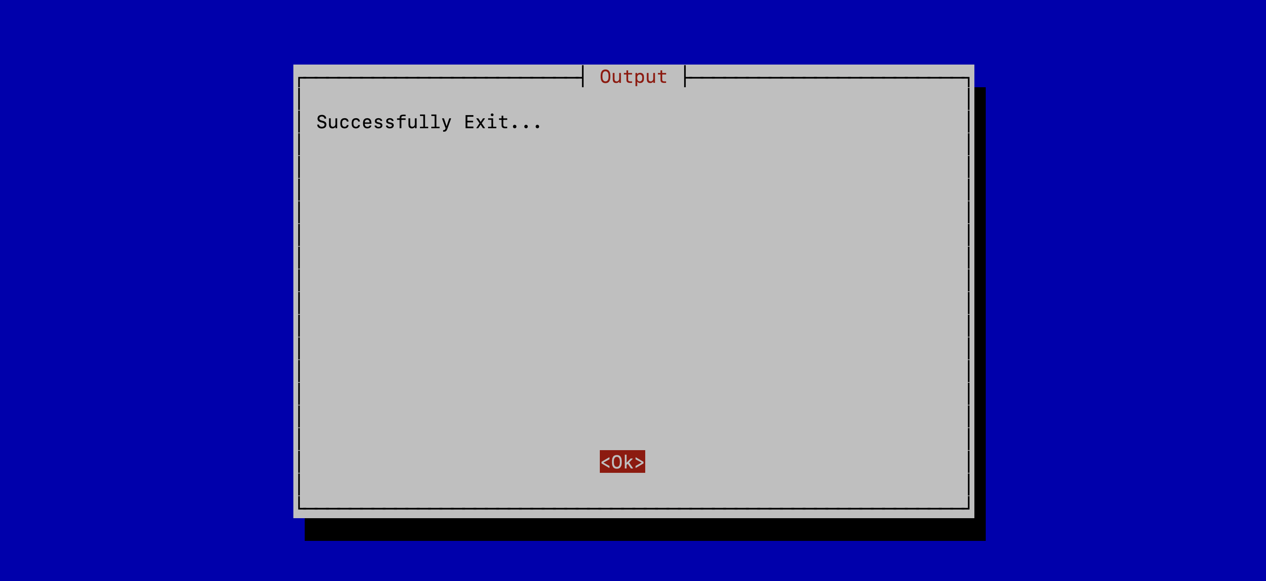
Result:
Figure 11: Closing the Program

Slide 18
Advantages
User-Friendly Interface
Automation of Common Tasks
Efficiency and Productivity
Real-Time Response with input

Slide 19
Future Scope of work
Advanced file operation
Enhanced user interface
Performance optimization

Slide 20
Conclusion
This project is a useful addition to any system administrator’s toolset since it streamlines routine file operations and offers a platform for users to learn about and develop their shell scripting skills.

Slide 21
References
Bash Shell Scripting Tutorials and Examples (w3schools.io)
www.javatpoint.com
Google
YouTube

Slide 22
Thank You !
Have a nice day !!

